Slide 1
PSYCHIATRY – MINOR MENTAL DISEASE.
DR. HARI SANKAR MD (Hom)
DEPT. OF PRACTICE OF MEDICINE
SARADA KRISHNA HOMOEOPATHIC
MEDICAL COLLEGE, KK DIST

Slide 2
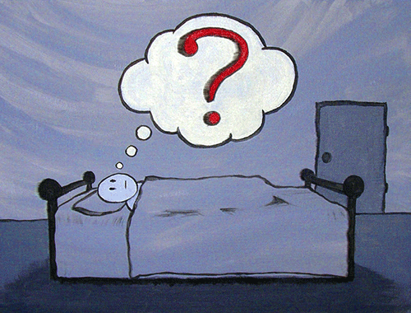
MINOR MENTAL DISORDER…..

Slide 3
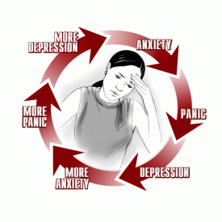
ANXIETY DISORDERS.
Anxiety is a subjective unpleasant feeling of fear, tension, impending danger and panic. The fear is usually accompanied by autonomic disturbances. There is no obvious external cause.
Types of anxiety disorders. These are:
• Generalised anxiety disorder
• Phobic anxiety disorder
• Panic disorder.

Slide 4
Generalised Anxiety Disorders (GAD). (Anxiety Neurosis)

Slide 5
In this disorder the anxiety is free floating and the symptoms are experienced all the time. It was previously known as anxiety neurosis.
Etiology:
The important causative factors include hereditary predisposition, morbid environment and constitutional defects. Physical factors such as infection, exhaustion and others may precipitate anxiety reaction.
Overactivity of the neurotransmitters such as norepinephrine, serotonin and gamma-aminobutyric acid (GABA) are seen in this disorder. Main pathological lesions are seen in the locus coeruleus.

Slide 6
Features of Generalised Anxiety Disorders
Clinical Features
The symptomatology can be classified as:
Mental
physical.
MENTAL SYMPTOMS
Severe anxiety
Irritability
Lack of attention and concentration
Worry
PHYSICAL SYMPTOMS
MOTOR
Restlessness
Tremors
Tension
CNS
Headache
Dizziness
Insomnia
CVS
Palpitation
Tachycardia
Precordical Pain
High Systolic BP
RESPIRATORY
Tachypnea
Breathlessness
Hyperventilation
GIT
Dysphagia
Dry Mouth
Diarrhea
GU TRACT
Frequency Of Micturition
Menstrual Irregularities
Sexual Dysfunctions
SKIN
Cold And Clammy

Slide 7
Clinical Features
The symptomatology can be classified as:
(a) mental,
(b) physical.
Mental symptoms: Anxiety is the main symptom. It is generalized and present throughout. It hampers the activities of the individual. Anxiety interferes with the functions of attention and concentration and there by the memory. Anxiety is the common cause of amnesia in students. The person is preoccupied by ‘worries’ and may have many kinds of anxious thoughts and
feelings.
Physical symptoms: General features are motor restlessness, fine tremors and generalised muscular tension. This causes aches and pains, especially frontal headache and backache. The pupils are dilated. The mouth is dry due to decreased salivation.

Slide 8
Cardiovascular manifestations: Tachycardia, rise in systolic blood pressure, precordial pain and palpitation are common.
Respiratory symptoms: Patients with GAD complain of breathlessness and tachypnea. Hyperventilation may lead to alkalotic tetany.
Gastrointestinal symptoms: These include dryness of mouth, dysphagia, diarrhea, constipation, vomiting abdominal pain, ‘gas’ and others.
Genitourinary symptoms: Anxiety disorder is associated with increased frequency of micturition. Sexual drive (libido) is often diminished. Menstrual
irregularities are found in women.
Central nervous symptoms: Headache is experienced as a tight band around the head. The patient experiences difficulty in getting into sleep. The sleep is light and fretful. The skin is cold and clammy.

Slide 9
Diagnosis: Clinical diagnosis can be made based on the somatic and psychic features. Persistent anxiety with
somatic symptoms is the important feature.

Slide 10
PHOBIC ANXIETY DISORDERS

Slide 11
This disorder is characterized by the presence of ‘phobia’. Phobia denotes fear which is specific to an object or situation. The fear is unreasonable and out of proportion to the demand of the situation. The subject avoids the object or situation which evokes the phobia.
Clinical features: The symptoms of phobia are very similar to those of generalised anxiety disorder but these symptoms occur only in the presence of the stimuli which evoke the phobia, either under imagination or in real situation. The patient is symptom-free at other times.

Slide 12
• In simple phobia, the fear is usually for harmless objects like pen, match box, spider and the like.
• In social phobia the fear is for social situations.
• In agoraphobia the fear is experienced on getting away from house or being in situations from which escape seem to be difficult.
Diagnosis: Diagnosis of phobia is based on the clinical features in relation to the phobic

Slide 13
Panic Disorder

Slide 15
The characteristic feature is sudden, unexpected episodes of intense anxiety. It is marked by chest pain, breathlessness, palpitation, sweating and a feeling of
imminent death or turning mad. The patient may run for help. It may be mistaken for acute myocardial pain. Sometimes it is associated with agoraphobia.
Diagnosis is made from the typical features.
Lactate infusion test: Intravenous infusion of sodium lactate precipitates panic reaction and this test can be used for diagnosis.

Slide 16
Thank you…

